Slide 1
Math 3360: Mathematical Imaging
Lecture 7:
Discrete Fourier Transform
Prof. Ronald Lok Ming Lui
Department of Mathematics,
The Chinese University of Hong Kong

Slide 2
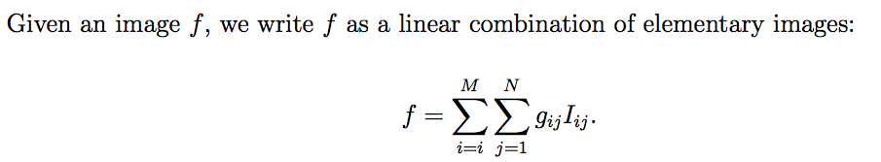
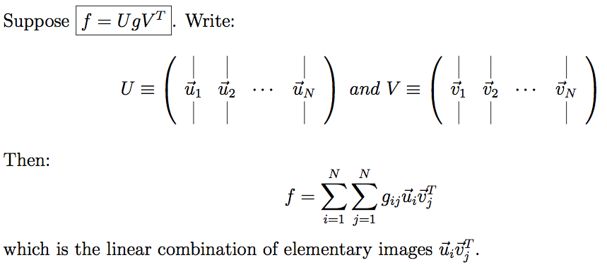
A quick revision: Image decomposition
What is image decomposition:
coefficients
Elementary images
(By truncating the terms with small coefficients, we can compress the image while preserving the important details)
Main technique for image decomposition:

Slide 3




A quick revision: Image decomposition
Main goal:
HOW TO CHOOSE U and V?
WHAT IS THE REQUIREMENT of g?
So far we have learnt:
Diagonal
SVD
Haar transform
Walsh transform
unitary
Sparse (hopefully)
Haar transform matrix
Sparse (hopefully)
Walsh transform matrix

Slide 4
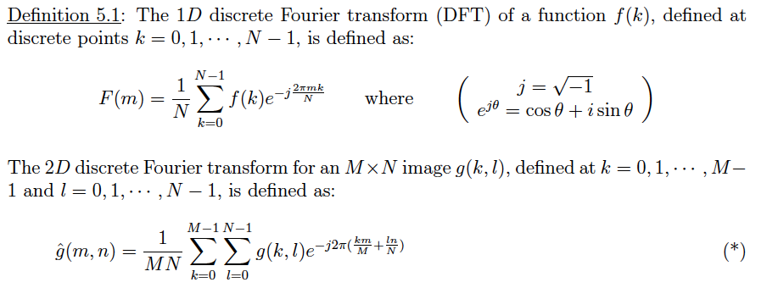
Recap: Definition of DFT
1D and 2D Discrete Fourier Transform:
  For details, please refer to Lecture Note Chapter 2

Slide 5
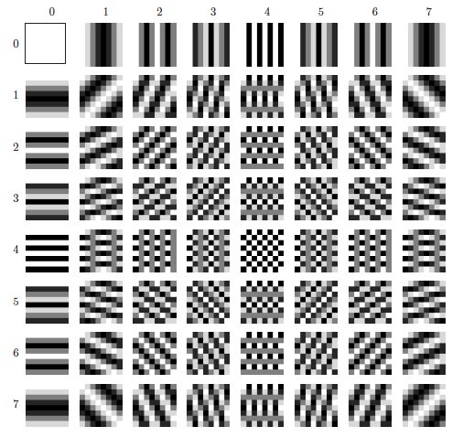
Elementary images of DFT decomposition

Slide 6
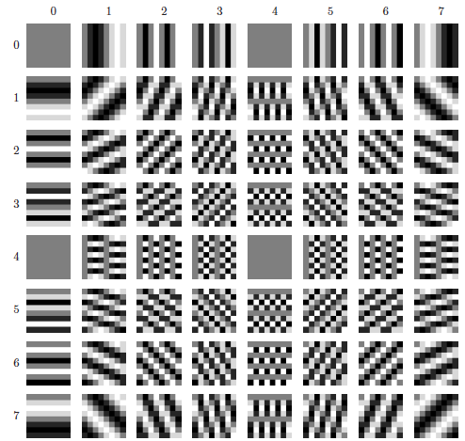
Elementary images of DFT decomposition

Slide 7
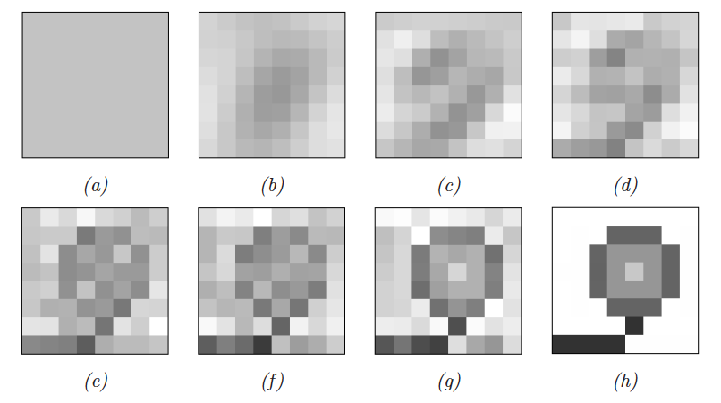
Reconstruction w/ DFT decomposition
= using 1x1 elementary images (first 1 row and first 1 column elementary images;
= using 2x2 elementary images (first 2 rows and first 2 column elementary images…and so on…

Slide 8
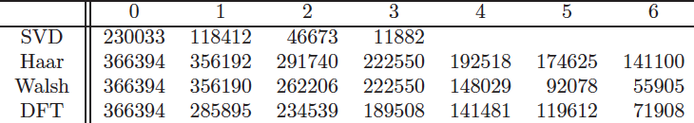
Comparison of errors
The flower example:

Slide 9
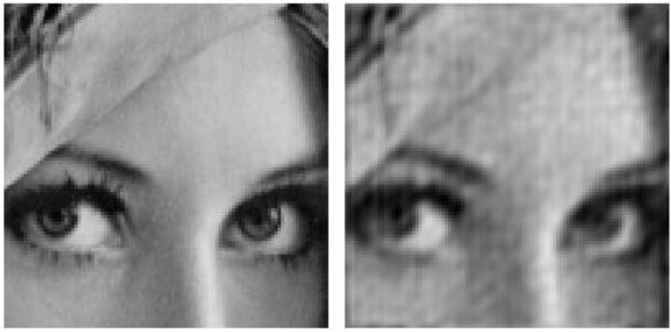
Real example
Original:
Compressed: 13.6:1
Truncating the small coefficients

Slide 10
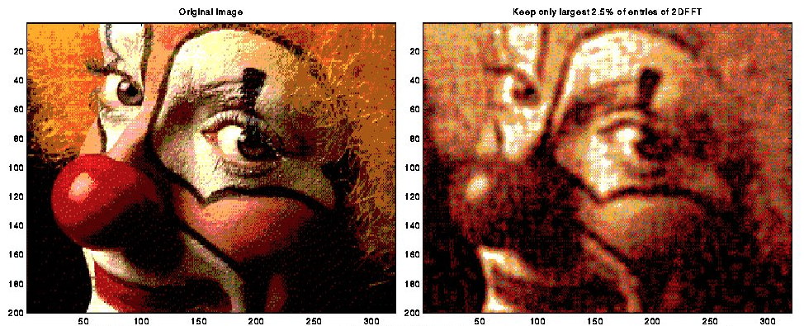
Real example
Original:
Compressed:

